Slide 1
SCIENCE
Know your subject Deeply

Slide 2
Subject Knowledge
Having a key knowledge of the Science curriculum across the school is important.
Knowing what is taught, when it is taught and why it is taught.
We have identified the key knowledge, skills and scientific vocabulary covered in each year group for each topic.
The document has been organised by topic so that it is clear to see the progression across each year group and key stage, allowing teachers to see the prior learning and future learning as well as their current year group expectation.

Slide 3
A great Science Knowledge organiser might look like…
Knowledge organisers are beneficial for all children in the classroom.
They should include the key vocabulary, key facts/learning and any key visuals.
They can be referred to throughout the topic and are useful when reviewing prior learning.

Slide 4
Vocabulary
Use of key scientific vocabulary should be evident in the children’s writing as well as when speaking about their learning.
Modelling the correct use of scientific vocabulary in an explanation is important.

Slide 6
Mastery opportunities in Science:
Challenging the children to pose their own questions.
Applying their new understanding of a concept to another scenario or example.
Answering ‘what if’ questions.
Challenges based on the scientific concept taught.
Children sharing and explaining their scientific understanding to peers.

Slide 7
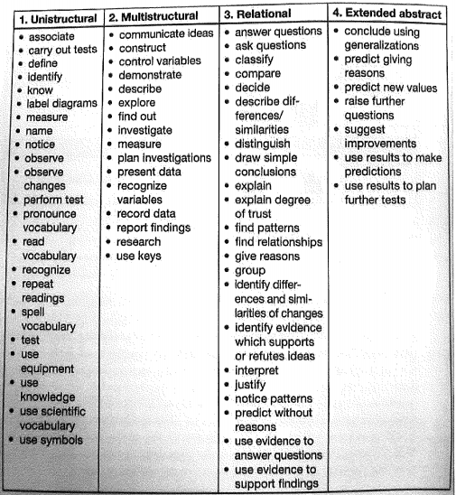
SOLO IN SCIENCE:
Solo taxonomy is not just used to structure a student’s response to a task, it can also be used to ensure that planned tasks are providing deeper learning opportunities.
Learning tasks set at the relational and extended abstract level allow for deeper learning to take place which supports the retention of the concepts.

Slide 8
Sentence stems to deepen learning in Science:
I think…
I agree because I know that…
I disagree because I know that…
I know this is wrong because…
A better way might have been to…
This clearly shows that…
I can prove this by…
To correct this I would need to…
I can therefore conclude that…

Slide 9
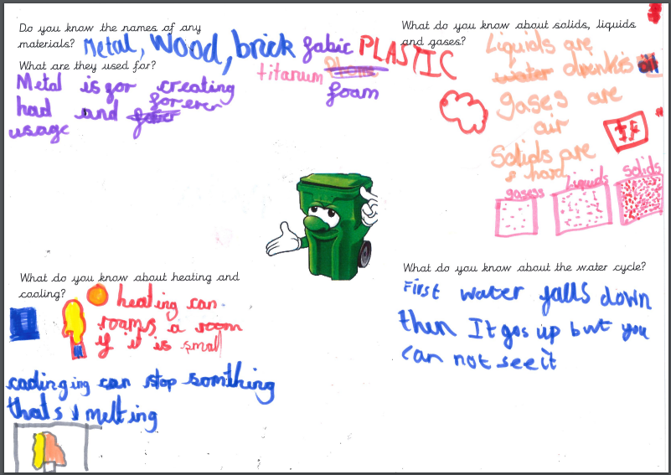
Retrieval practice in Science:
Low stake quizzes at the beginning, mid way and end of a topic. Quizzes can focus on current topic, previous topics throughout the year and prior learning from the year before.
Knowledge dumps – allowing children to put all their prior knowledge down on paper as a starting point for a topic. Can also be used to review learning throughout a topic.
Opportunities for children to discuss what they remember from previous lessons
What did we do yesterday? What do you remember?

Slide 10
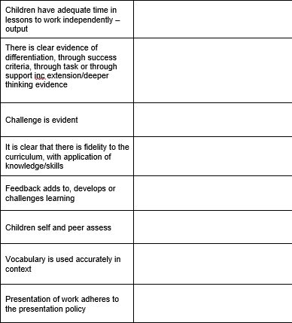
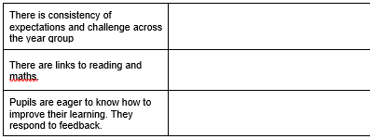
Work Scrutiny – what did we find out?
Ensure correct curriculum coverage – sufficient number of lessons being taught each week – consistency across the year group.
Is there a reliance on schemes? Do the books look worksheet heavy? Is there evidence of enough practical?
How are the lessons being differentiated?
Is there an expectation on what feedback should look like?
Is there evidence that the children are using correct vocab?

Slide 11
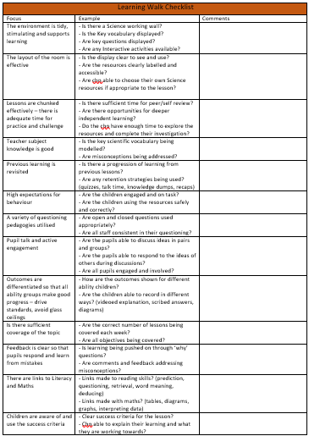
A learning walk might look for:
The learning environment – tidy, stimulating, supports learning, effective layout, working wall, vocabulary displayed.
Format of the lessons – effective use of time, adequate time for practical, mini plenaries for feedback and discussion, adequate time for challenge and review.
Outcomes differentiated – outcomes according to ability, recording of outcomes in different ways.
Links to Literacy and Maths

Slide 12
Effective Feedback in SCIENCE might look like:
Feedback within lessons to address misconceptions and encourage use of correct scientific vocabulary
Feedback should be linked to the learning intention and move learning forward.
Use of ‘why’ questions to promote deeper learning
Pupils are able to respond to feedback and marking within books.
Feedback is specific and clear.

Slide 13
Deliberate Practice In SCIENCE:
Give a question, discuss, model, investigate independently, review.
Revisiting through quizzes (retrieval practice)
Children choosing their own resources that they think are suitable to their investigation, give feedback and discuss suitability of choices, model use of resources in investigation, try again.

Slide 14
What we might ask children about SCIENCE:
What is Science? What is a scientist?
Do you find this subject challenging? Why?
What do you already know about this topic?
How will you make sure that you remember this learning?
Show me something that you have learnt recently.
How does this learning fit in with what you have already learnt?
What did you learn from doing this experiment?
What would you change next time?

