Slide 1
Challenge Partners – The QA Review

Slide 2
THE QA REVIEW – in a nutshell
The QA Review is a collaborative peer review developed by Challenge Partners
REVIEW TEAM
REVIEW
REVIEW REPORT
Lead Reviewer
Ofsted-experienced
What Went Well
What are my strengths?
Even Better If
Where can I improve?
Reviewers
Senior leaders from across the partnership
Area of Excellence
What can I share?
Size of review team depends on size of host school
Review team and host school’s SLT review school collaboratively – ‘one team, two parts’
Review report is shared with Central Team and Hub Manager to enable follow-on support

Slide 3
THE QA REVIEW – What is it?
The QA Review and our support programmes aim to provide schools and senior leaders with:
AUDIT
CHALLENGE
SUPPORT (inc senior leader CPD)
Where is a school at right now?
Where does a school need to be?
How can we support the school and its senior leaders to get there?
By having a review
By accessing post-review support
By reviewing another school

Slide 4
THE QA REVIEW AND OFSTED
Area | QA Review | Ofsted
School context
School improvement strategies
Outcomes for pupils
Quality of teaching, learning and assessment
Area of excellence
Improvements from last review
Personal development, behaviour and welfare
Effectiveness of leadership and management
Governance
QA Review | Ofsted Inspection
The QA Review does not look at the same areas as Ofsted and so agreed estimates from the review are not equivalent to Ofsted judgements; nor do we intend them to be.

Slide 5
THE QA REVIEW – Timetable
Takes place over 3 days beginning on either a Monday or a Wednesday
One afternoon for the Pre-Review Analysis (PRA)
One full day of review activities
One morning for further review activities and concluding meetings

Slide 6
THE QA REVIEW - Principles
Regularity
Every school in the partnership receives a review every year to enable them to regularly audit their progress and identify improvements
Reciprocity
Every school is reviewed by a team made up of reviewers from across the Partnership. Every school is expected to send out an equal or greater number of reviewers to review other schools in schools across the country for three days
Rigour
The review is based on a solid foundation of theory and experience, and is delivered according to a rigorous framework by an Ofsted-experienced Lead Reviewer

Slide 7
THE QA REVIEW – Annual Central Team cycle (Apr 18 – Mar 19)
PLANNING & DELIVERY
Review Scheduling
May
Review Delivery
Oct- March
450+ Reviews across
31+ Hubs
450+ Reviews Across 31+ Hubs
Feedback from schools, Lead Reviewers and reviewers
Apr
Mar
Reviewer Training
Jun- Jul
Lead Reviewer Training
June & September
Reviewer Training
Autumn
400+ reviewers over
20+ sessions
40+ Lead Reviewers over 2 sessions
100+ reviewers over
5+ sessions
TRAINING & QUALITY ASSURANCE

Slide 8
THE QA REVIEW - Preparation
All this information is contained within the QA Review Handbook, and all resources can be found on the website in the Network of Excellence resources
Reflect
What do you want to get out of the Review?
How have other schools in your hub used it?
What progress have you made against last year’s EBIs?
Create a draft timetable
Complete an Area of Excellence form (if you want to put one forward)
Print out your documentation for the Pre-Review Analysis (including any current data)
Read the QA Review Handbook
Plan
Communicate
Decide teachers to be observed
Talk through expected contribution with your SLT
Inform all involved from your own school
Let your Hub Manager know – they may wish to attend the final meeting

Slide 9
THE QA REVIEW- After
Your review report is shared with the Central Team and your Hub Manager to enable follow-on support
REVIEW REPORT
SUPPORT FROM YOUR HUB
What Went Well
What are my strengths?
Hub Manager
Connect with other schools in your Hub
Hub Meetings
Share challenges, identify solutions
SUPPORT FROM THE PARTNERSHIP
Even Better If
Where can I improve?
School Support Directory
Connect with other schools across the partnership
Area of Excellence
What can I share?
Leadership Development Days
Observe good practice in action across the partnership
Contact us!
Give us a call or email: review@challengepartners.org

Slide 10
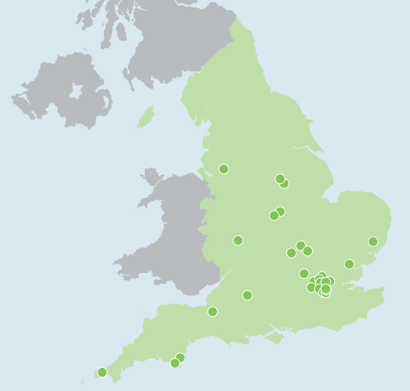
THE QA REVIEW SO FAR – In 6 years, we have…
Conducted over 1700 reviews
Deployed 4,000+ reviewers
Trained over 3,500 reviewers
Trained 45 Lead Reviewers
Rating last membership year from headteachers for the QA Review as a learning experience for them and their staff
4.5/5
Rating last membership year from reviewers for contribution to their CPD
4.6/5

Slide 11
IMPROVEMENT THROUGH STRUCTURED COLLABORATION
Each school goes through an annual cycle within their local CP hub
4. Monitoring & evaluation
Ongoing monitoring
Hubs submit impact evaluation
Informs next year’s audit
1. Annual audit
School peer review
Data analysis
Headteacher and senior leader conversations
3. Programme of support
e.g. Leadership residencies, training, school visits, shadowing, coaching, subject networks, Challenge the Gap…
2. Objectives & plan
Share audit outcomes
Collaboratively agree priorities
Create school and hub action plans

